Slide 1
Multi Agent Deep Reinforcement Learning
Zahra Parham

Slide 2
When it is not in our power to determine what is true, we ought to act in accordance with what is most probable. Descartes

Slide 3
Introduction of the Project
Reinforcement Learning
Deep RL
Multi-Agent DRL
Related Work
Main Work
Future Work

Slide 4
Introduction of the project

Slide 5
What is reinforcement learning?

Slide 6
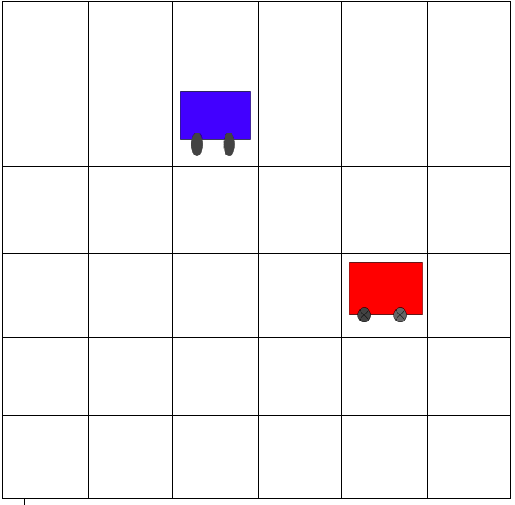
Notes:
the environment of my project

Slide 7
Discrete environment 10 * 10
Two different types of agents : thief agent and police agent
Each of them has 9 movements
Agents have no data about the game environment and game rules
Our goal is: the police agent catch the thief agent and the thief agent escape from the police agent
Two agents learn these policies in collaboration with each other

Slide 8
How we can solve this problem?

Slide 9
Reinforcement learning with the help of deep learning allows us to design a model so that learning happens automatically for each agent

Slide 10
Reinforcement Learning

Slide 11
Reinforcement learning (RL) is an area of machine learning that focuses on how you, or how something, might act in an environment in order to maximize some given reward. Reinforcement learning algorithms study the behavior of subjects in such environments and learn to optimize that behavior.

Slide 12
Supervised Learning: y = f(x)
Unsupervised Learning: f(x)
Reinforcement Learning: y =f(x)
z

Slide 13
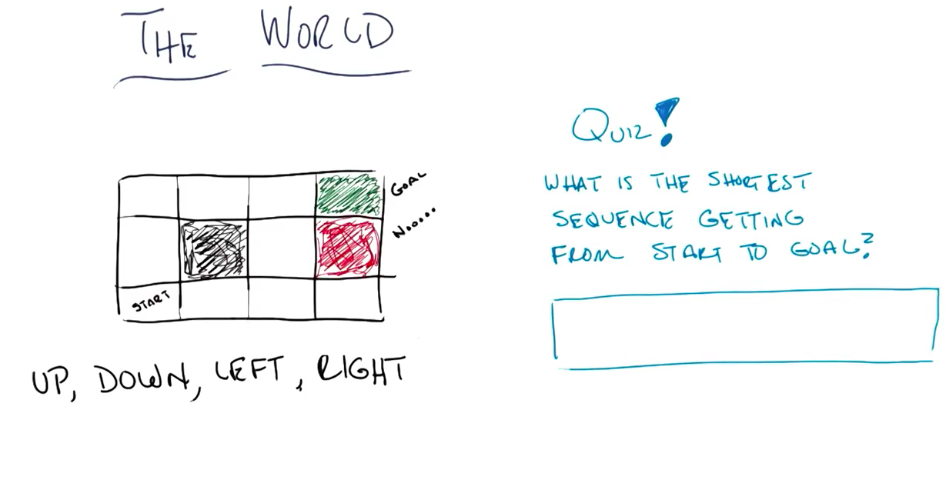

Slide 14
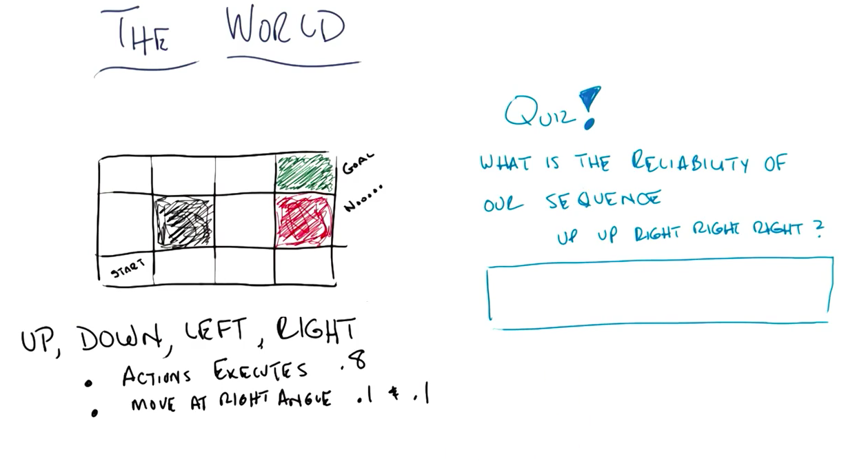

Slide 15
Markov Decision Processes (MDPs)

Slide 16
Markov decision processes give us a way to formalize sequential decision making. This formalization is the basis for structuring problems that are solved with reinforcement learning

Slide 17
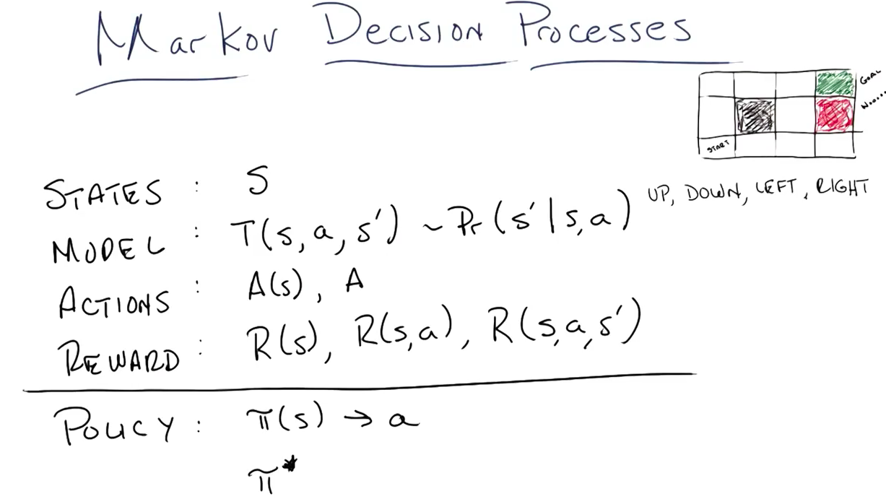
Notes:
Transition model describes the rule of the game
Policy: a function that takes in a state and returns an action.
Optimal policy: maximazies your long-term expected reward

Slide 18
Components of an MDP:
Agent
Environment
State S
Action A
Reward R
model
policy

Slide 19
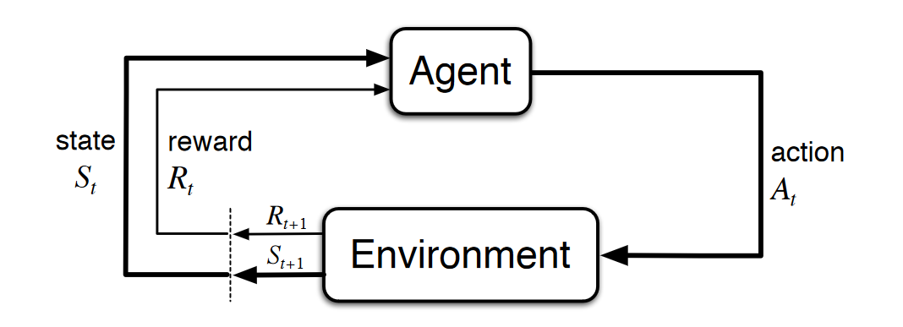

Slide 23
It is the agent’s goal to maximize the cumulative rewards.

Slide 24
It is the agent’s goal to maximize the expected return of rewards.

Slide 25
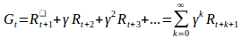
It is the agent’s goal to maximize the expected discounted return of rewards.

Slide 26
How good is a state or action?

Slide 27
Policies and value functions

Slide 28
How probable is it for an agent to select any action from a given state?
How good is any given action or any given state for an agent?

Slide 29
A policy is a function that maps a given state to probabilities of selecting each possible action from that state.
We will use the symbol 𝜋 to denote a policy

Slide 30
Action-value function
tells us how good it is for the agent to take any given action from a given state while following policy 𝜋

Slide 31
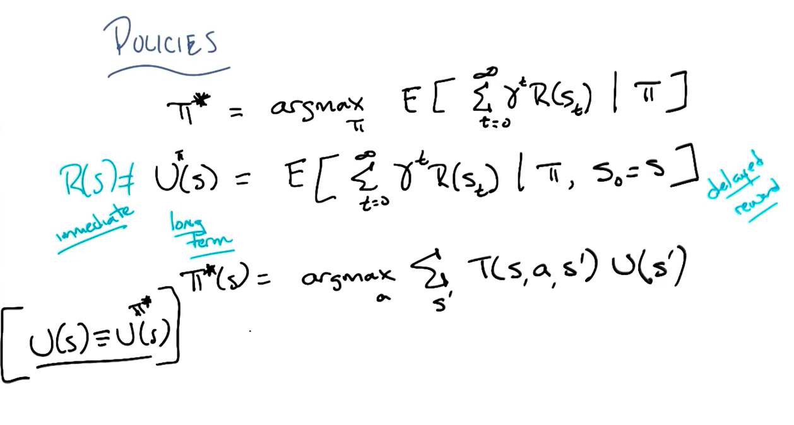

Slide 32
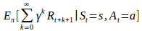
=
Notes:
Conventionally, the action-value function 𝑞
is referred to as the Q-function, and the output from the function for any given state-action pair is called a Q-value.

Slide 33
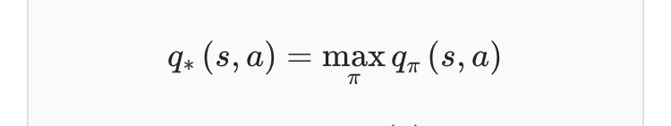
Optimal action-value function

Slide 34
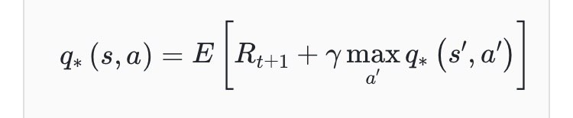
Bellman optimality equation
Notes:
t states that, for any state-action pair
(𝑠,𝑎) at time 𝑡, the expected return from starting in state 𝑠, selecting action 𝑎
and following the optimal policy thereafter (AKA the Q-value of this pair) is going to be the expected reward we get from taking action 𝑎 in state 𝑠, which is 𝑅𝑡+1, plus the maximum expected discounted return that can be achieved from any possible next state-action pair
Q function Q value

Slide 35
The Q-learning algorithm iteratively updates the Q-values for each state-action pair using the Bellman equation until the Q-function converges to the optimal Q-function
Q-learning

Slide 36
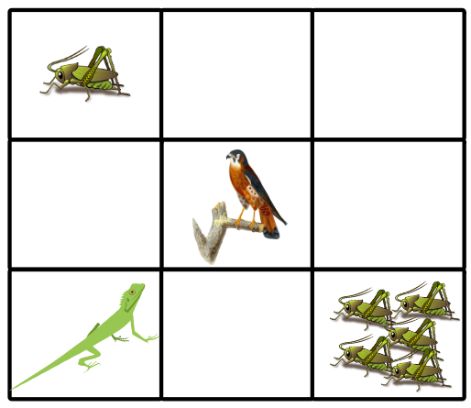

Slide 37
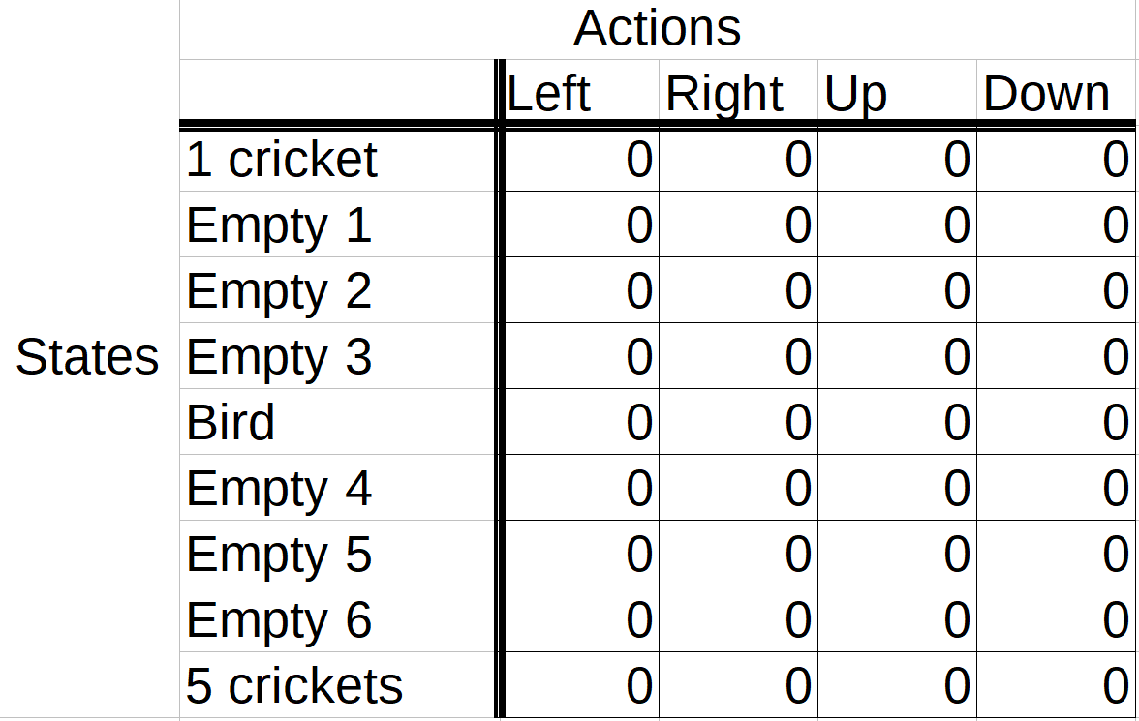

Slide 38
Exploration vs. exploitation

Slide 39
Epsilon greedy strategy

Slide 40
if random_num > epsilon:
# choose action via exploitation
else:
# choose action via exploration

Slide 41
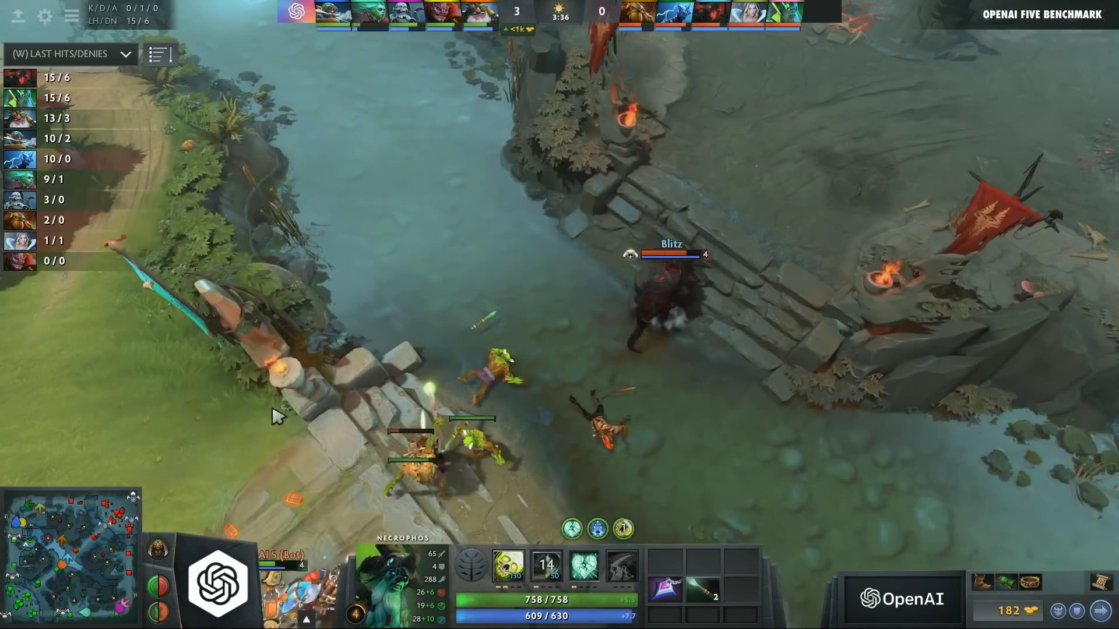

Slide 42
Deep reinforcement Learning

Slide 43
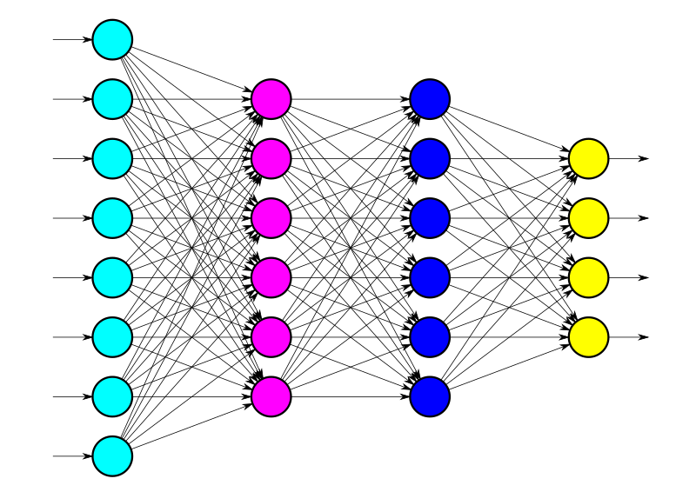
Notes:
We’ll make use of a deep neural network to estimate the Q-values for each state-action pair in a given environment, and in turn, the network will approximate the optimal Q-function.

Slide 44
Deep Q-learning
Notes:
The act of combining Q-learning with a deep neural network is called deep Q-learning, and a deep neural network that approximates a Q-function is called a deep Q-Network, or DQN.

Slide 45
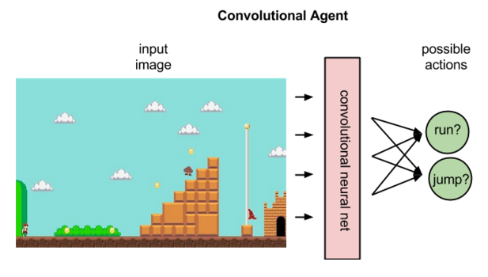

Slide 46
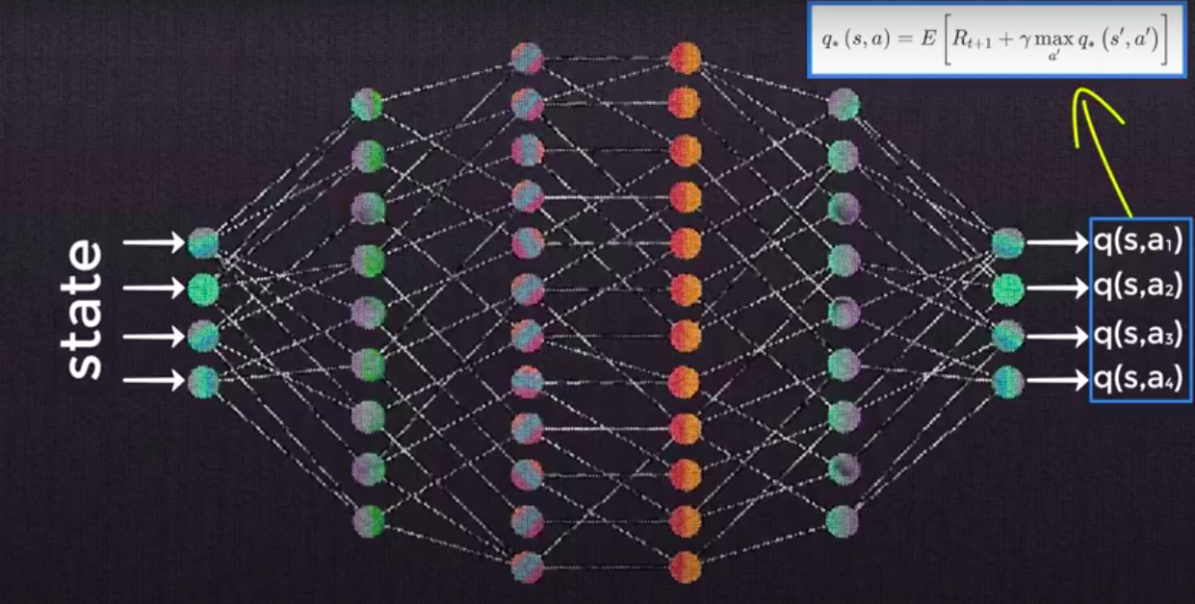

Slide 47
Experience Replay and
Replay Memory

Slide 48
With deep Q-networks, we often utilize this technique called experience replay during training. With experience replay, we store the agent’s experiences at each time step in a data set called the replay memory.

Slide 49
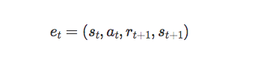

Slide 50
If the network learned only from consecutive samples of experience as they occurred sequentially in the environment, the samples would be highly correlated and would therefore lead to inefficient learning. Taking random samples from replay memory breaks this correlation.

Slide 51
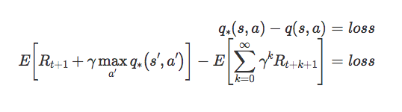

Slide 52
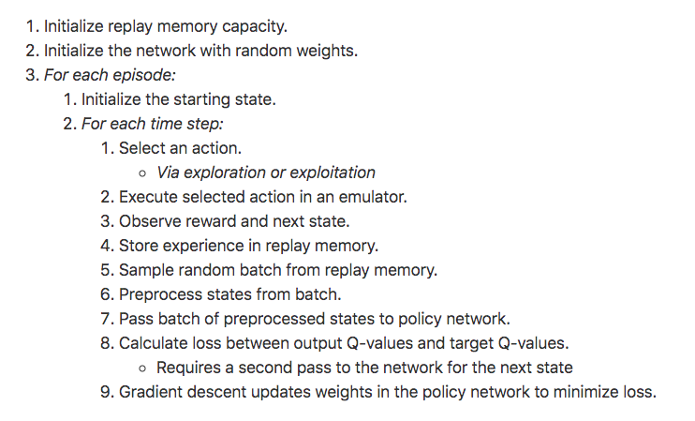

Slide 53
Target Network

Slide 54
when our weights update, our outputted Q-values will update, but so will our target Q-values since the targets are calculated using the same weights. So, our Q-values will be updated with each iteration to move closer to the target Q-values, but the target Q-values will also be moving in the same direction.

Slide 55
this makes the optimization appear to be chasing its own tail, which introduces instability. As our Q-values move closer and closer to their targets, the targets continue to move further and further because we're using the same network to calculate both of these values.

Slide 56
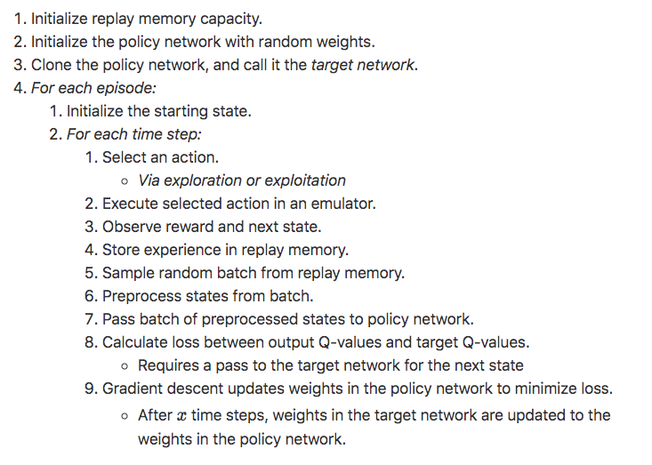

Slide 57
Multi-agent Deep Reinforcement Learning

Slide 58
There exist several possible adaptations of the Q-learning algorithm for the multiagent case. In practice the simplest method consists of using an autonomous Q-learning algorithm for each agent in the environment, thereby using the environment as the sole source of interaction between agents. In this work we use this method due to its simplicity, decentralized nature, computational speed, and ability to produce consistent results for the range of tasks we report. Therefore, in our tests each agent is controlled by an independent Deep Q-Network with architecture and parameters as reported in

Slide 59
Related Work

Slide 61
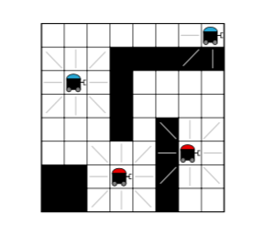

Slide 62
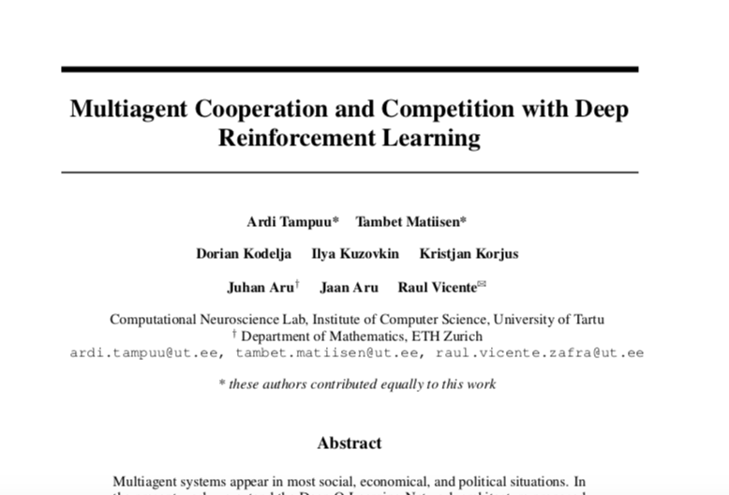

Slide 63
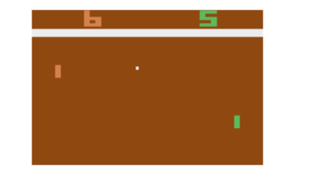

Slide 64
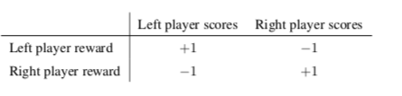
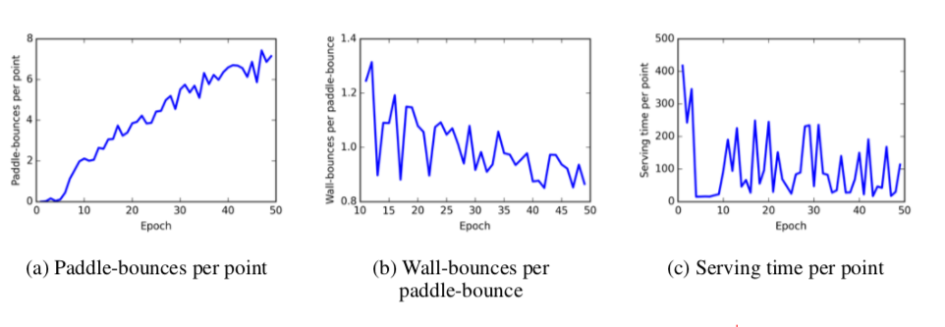

Slide 65
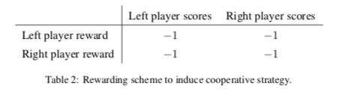
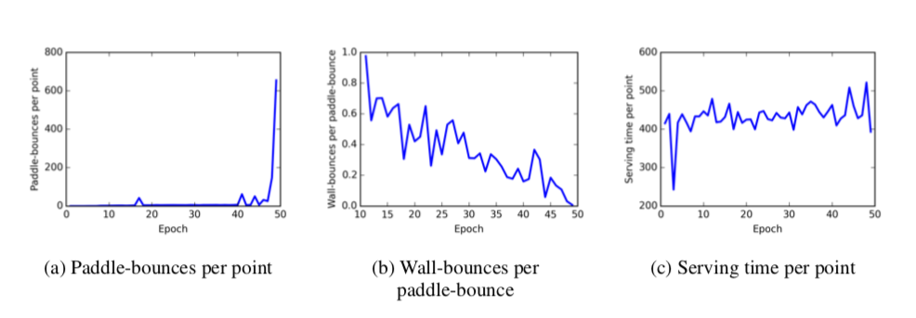

Slide 66
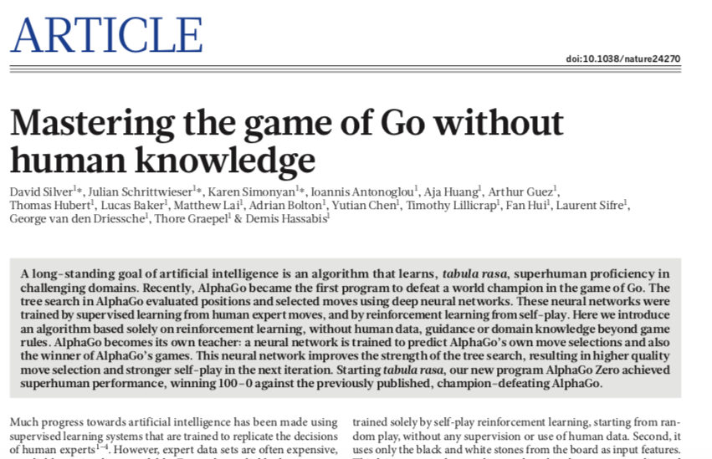

Slide 67
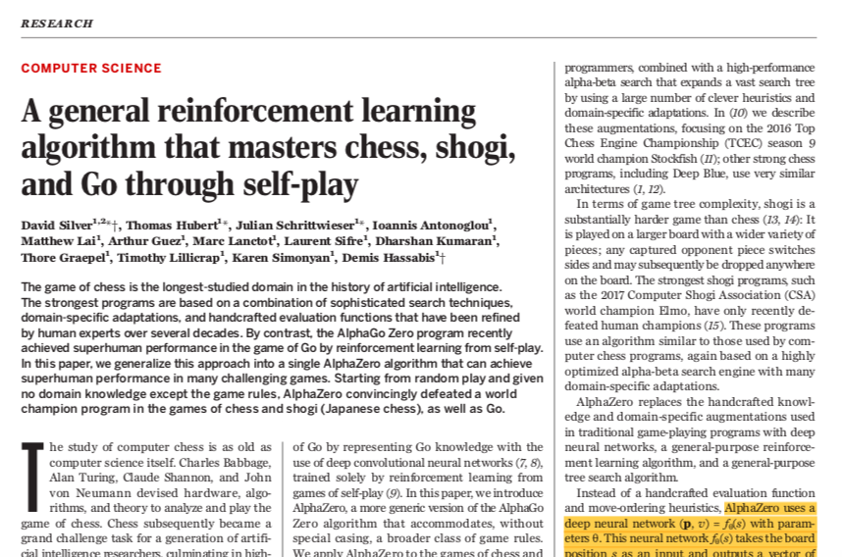

Slide 68
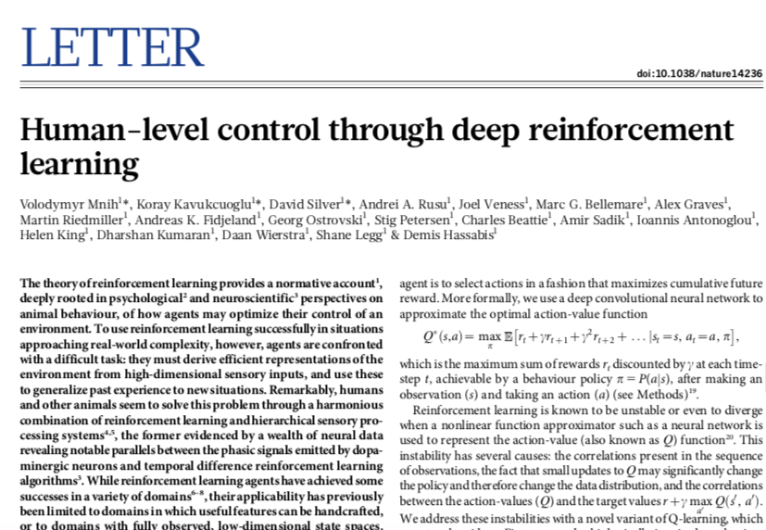

Slide 69
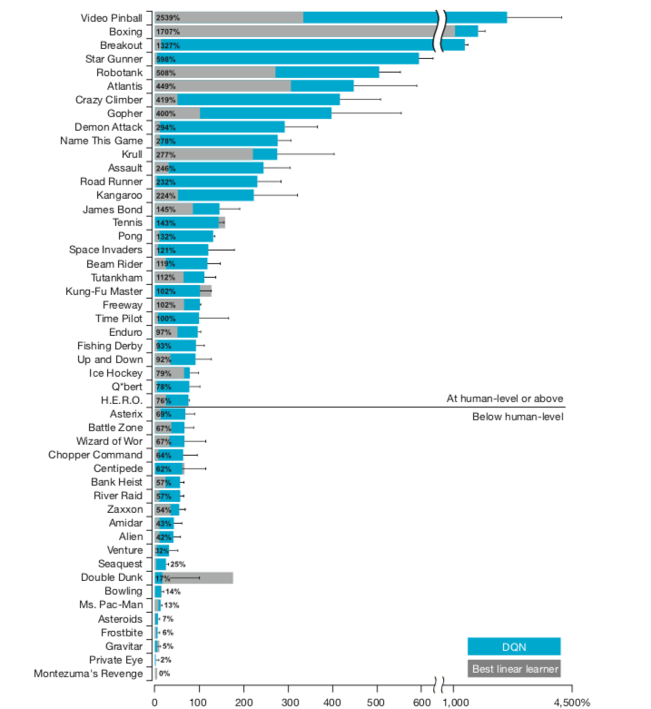

Slide 70
Main Work

Slide 71
Notes:
the environment of my project

Slide 72
Reward scheme

Slide 73
If the police capture the thief, it gets 25 points and the thief loses 25 points. On the other hand, for each step that the police take, one point is lost and the thief gets one point.
This makes it essentially a zero-sum game, where a positive reward for the police player implies a negative reward of the same size for the thief player and vice versa.

Slide 74
each agent has their own convolutional neural network controller that takes the pixels of an image as input and as output, represents the Q-values for all the actions the agent can take from that state.

Slide 75
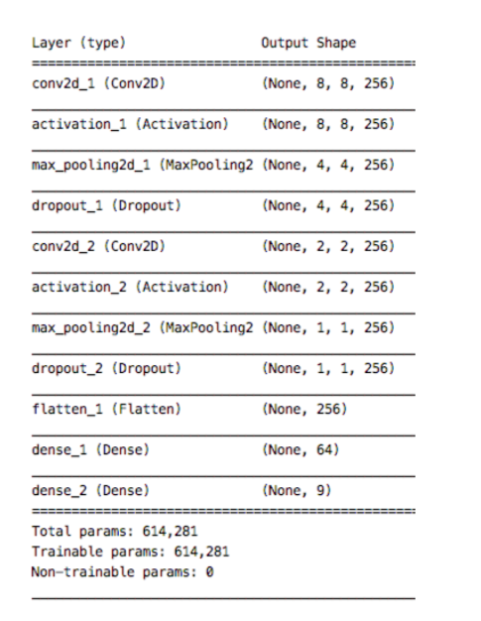

Slide 76
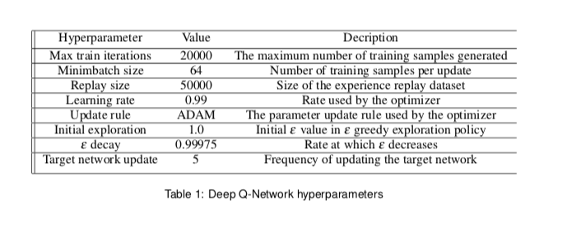

Slide 77
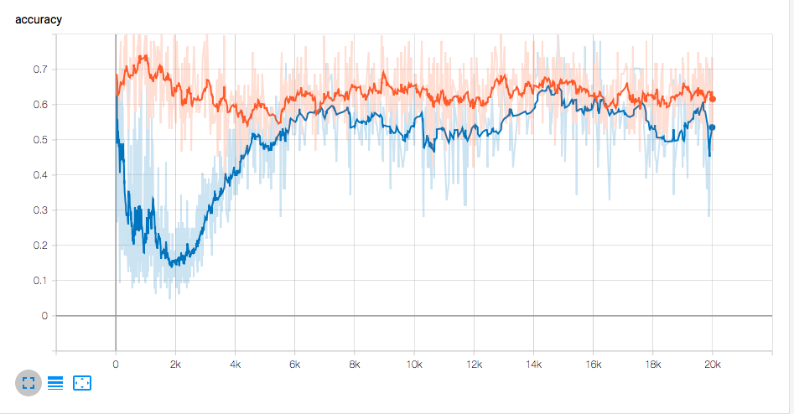

Slide 78
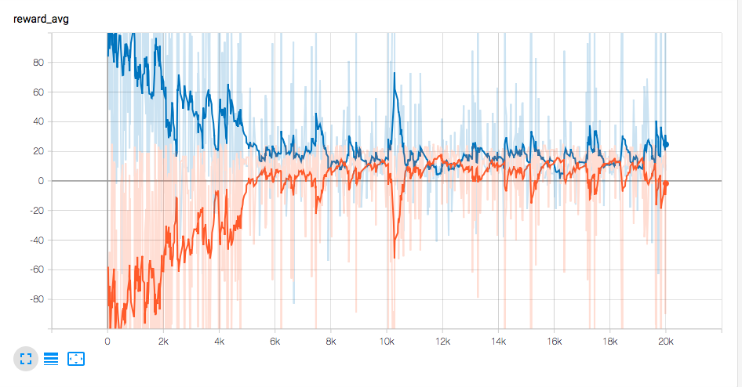

Slide 79
Future Work

Slide 80
There are a number of potential directions for future work. One of the things that can be done in the future is to increase the number of agents and also we can use a partially observed environ- ment here each agent is only able to see a few houses around it and the whole game environment is not obvious for them, in which case agent can use other associate agents to find the thief.

Slide 81
Another area of future work would involve extending this approach to more complicated domains. One potential application is robotic soccer. Specifically, selective coordination approaches have been shown to work well for robot soccer.

Slide 82
Thank You!

